Slide 1
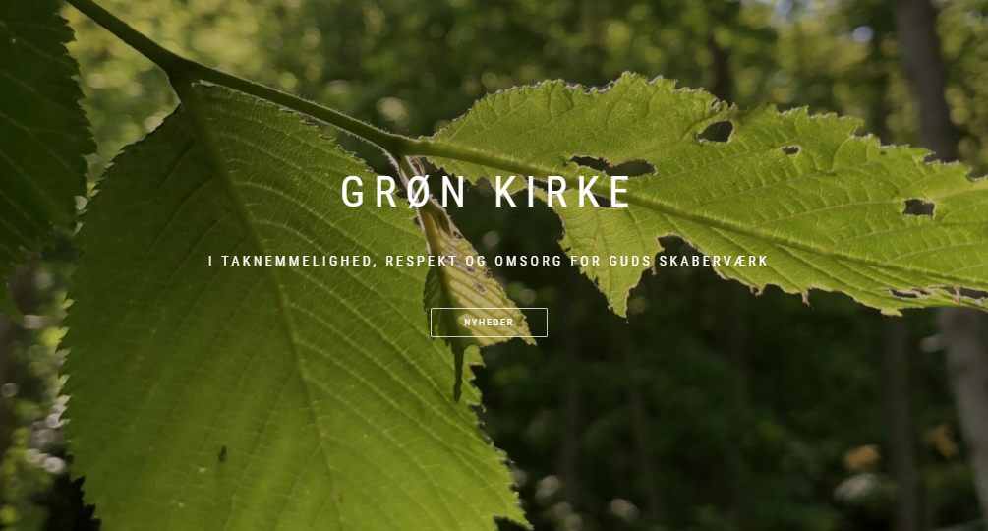

Slide 2
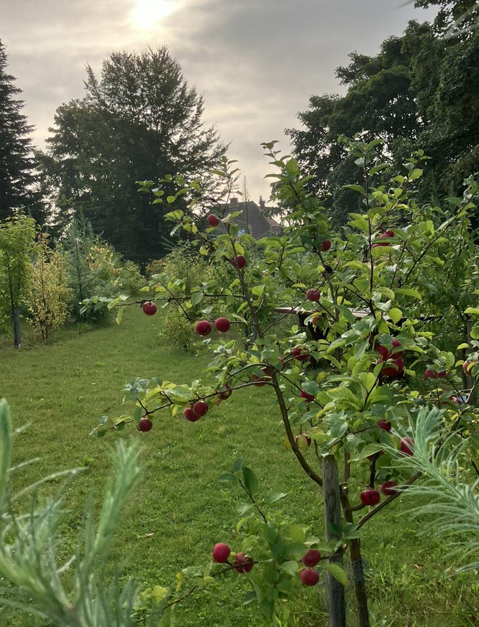
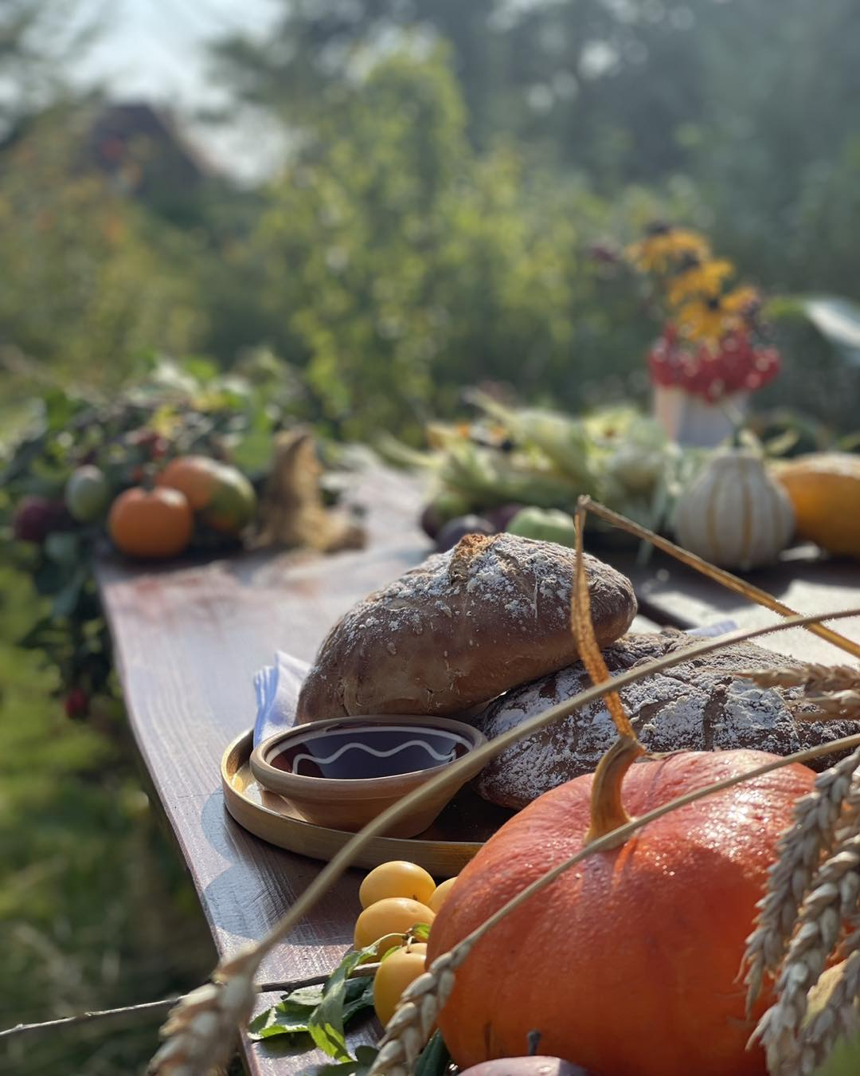
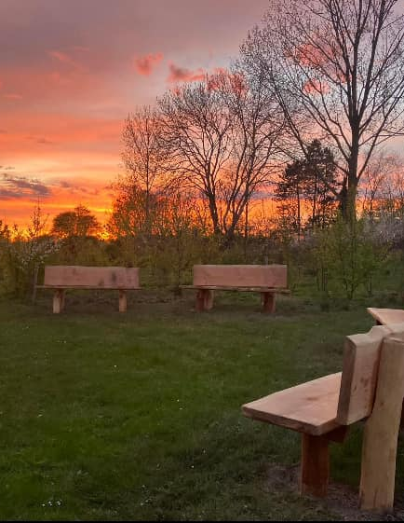
From traditional harvest fest to season of creation service
Evangelical Lutheran Church of Denmark

Slide 3
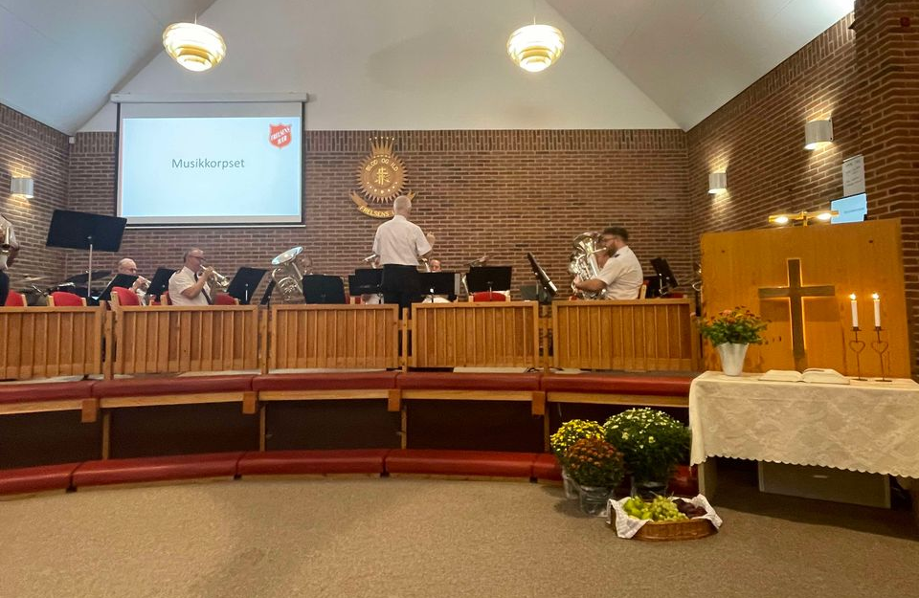
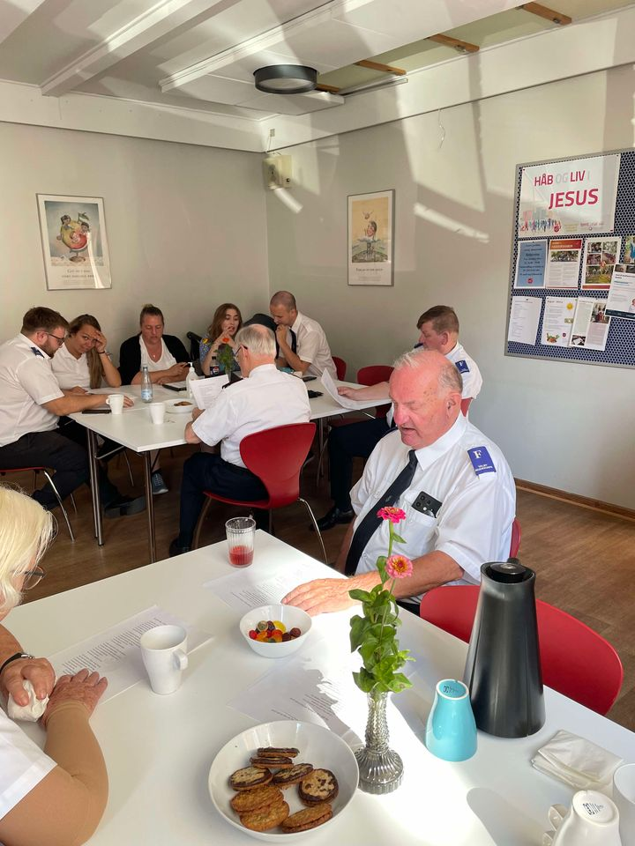
Season of creation ”conversation service” on climate and environment
Salvation Army

Slide 4
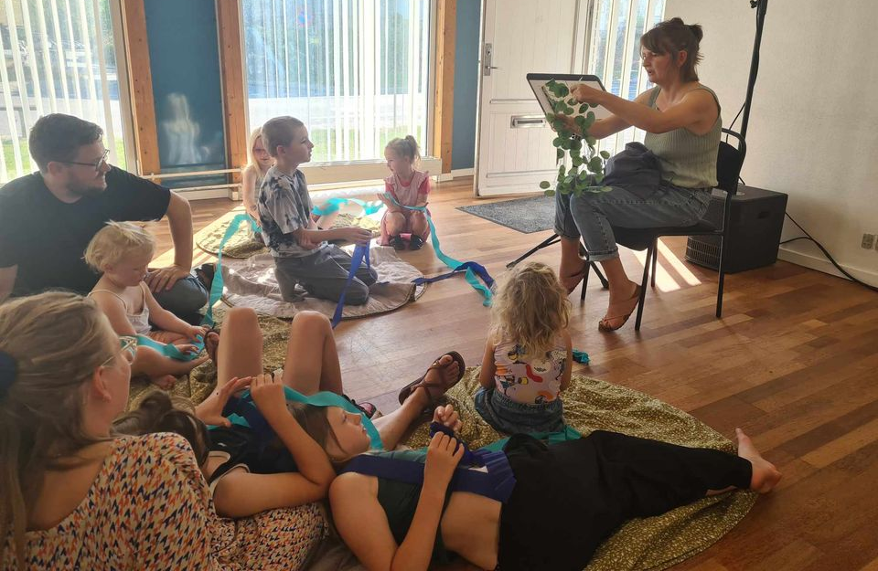
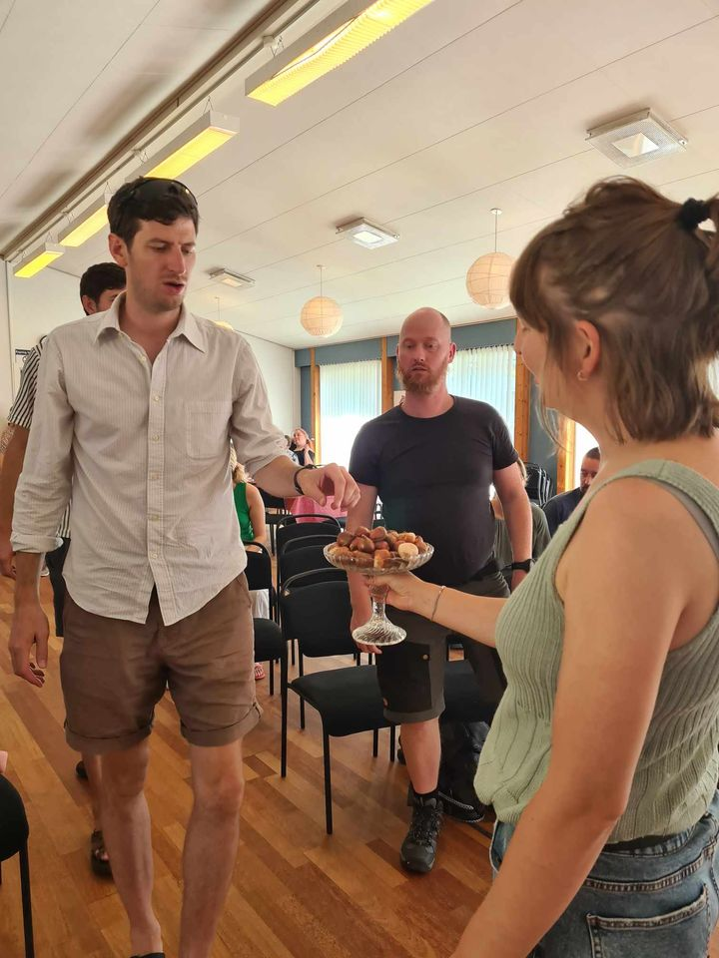
Season of creation familiy worship service
Vineyard

Slide 5
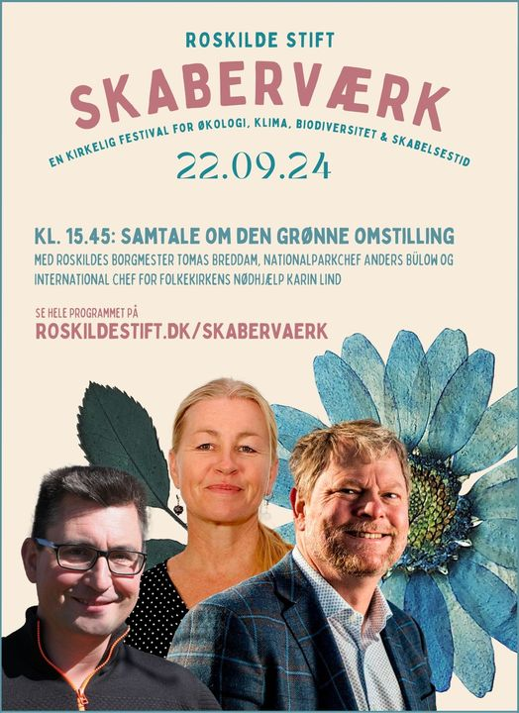
Season of creation one day festival
Roskilde Cathedral (Evangelical Lutheran Church of Denmark)

